Slide 1
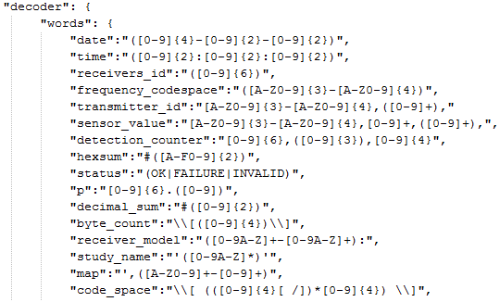
Decoder Module
Determines type of message sent by receiver.
Decodes messages using configurable RegEx.
450052,007,2012-10-02 21:49:36,A69-9001,30444,#CC

Slide 2
Database Module
Takes decoded messages from Decoder.
Makes insertions into the database.
Physical receiver → Unparsed message → Decoder → Decoded message → Database insertion

